Slide 1
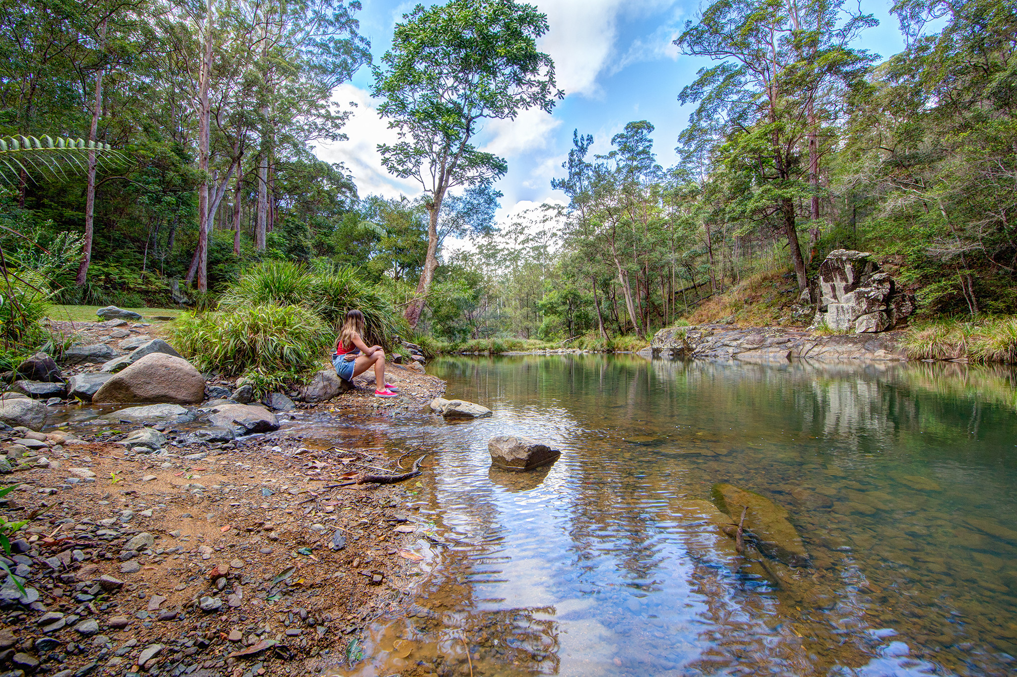


Strategic Waterways Course Overview: Why Strategic Waterways

Slide 2
Strategic Waterways Course Overview:
Changes and updates
How do we best manage our waterways?
A typical approach
Why we need to think differently
Complex system
Barrier bypass
Hotspots and hot moments
Risk hotspots
Opportunity hotspots

Slide 3
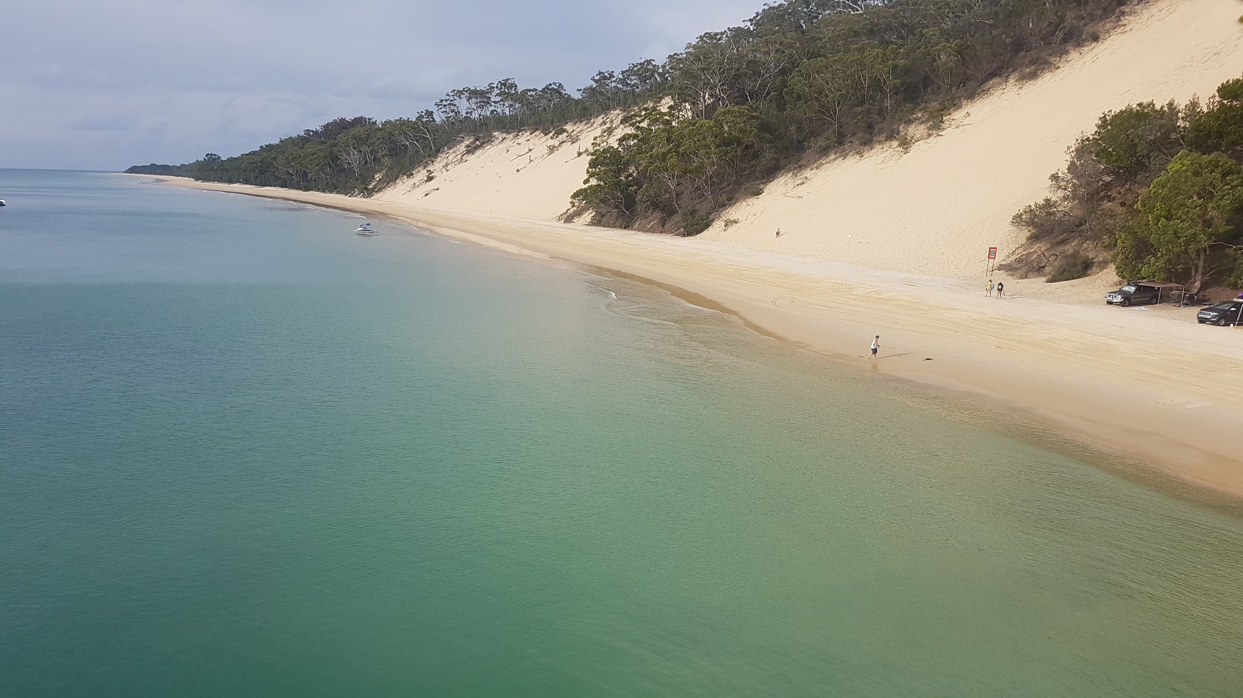
How do we best manage our waterways?
Notes:
The focus question for my presentation today, is not how do we manage our waterways, but how do we BEST manage our waterways.

Slide 4
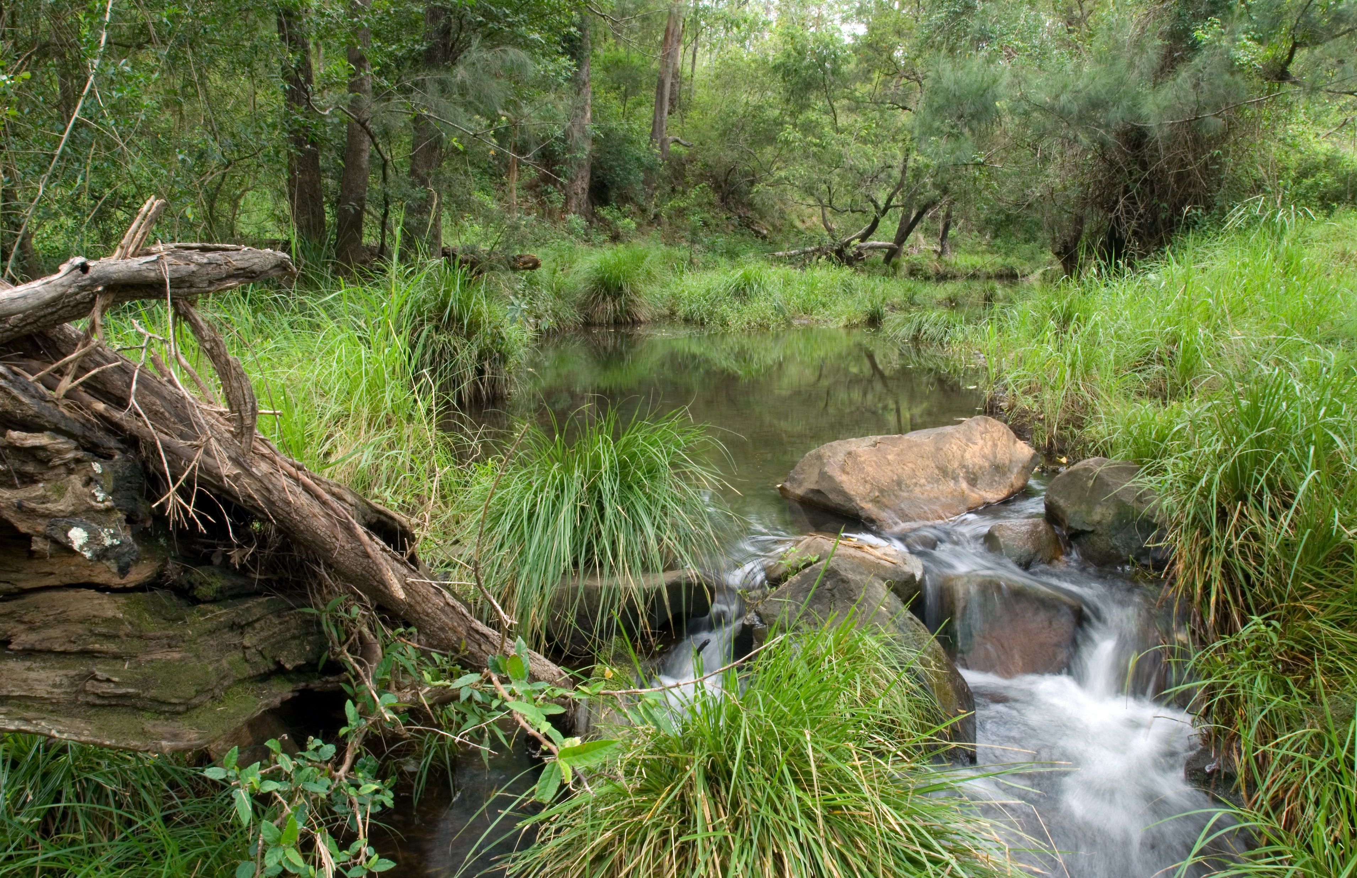
A typical approach to manage risk
Sediment & Nutrients
Water Quality
BIORETENTION
The Stormwater Management Design Objectives (SMDOs) e.g. 80/60/45 is used to determine the size of these bioretention basins
Typically bioretention is used to shield our waterways
Notes:
For stormwater pollution in Australia we mainly use Bioretention basins to mitigate sediment and nutrient pollution. One thing we can observe from this diagram is that if we implement a bioretention basin, the sediment pond now becomes redundant (and not a priority).

Slide 5
Why we need to think differently
Reason 1: Threats don’t just occur in operation phase
Reason 2: Fish survival depends on many things – not just 80/60/45
Reason 4: There are many different ways to manage waterway health
Reason 5: 80/60/45 won’t address climate impacts
Reason 6: Waterway health can be damaged from acute events
Reason 7: Focus efforts on geographic hotspots
Reason 8: Look for strategic opportunities to enhance value
Reason 9: Limited time and resources

Slide 6
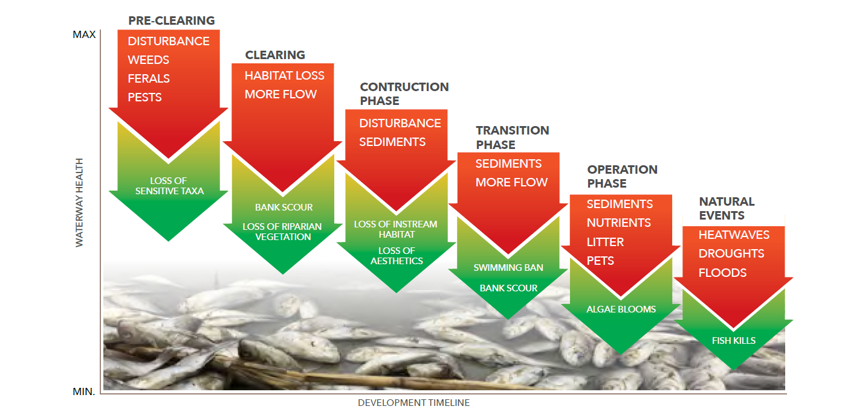
Why we need to think differently
Reason 1: Threats don’t just occur in operation phase

Slide 7
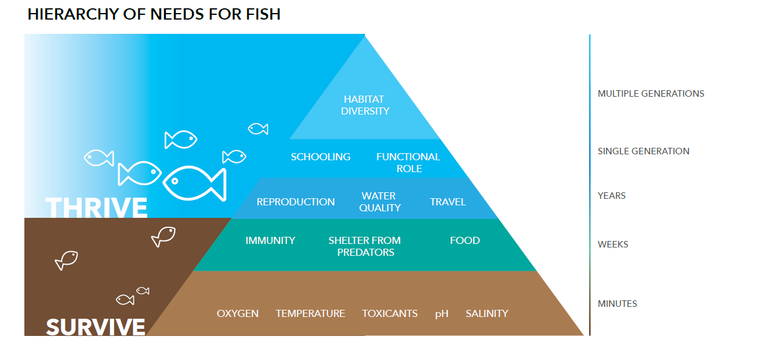
Reason 2: Fish survival depends on many things – not just Stormwater Design Objectives (i.e. 80/60/45)

Slide 8
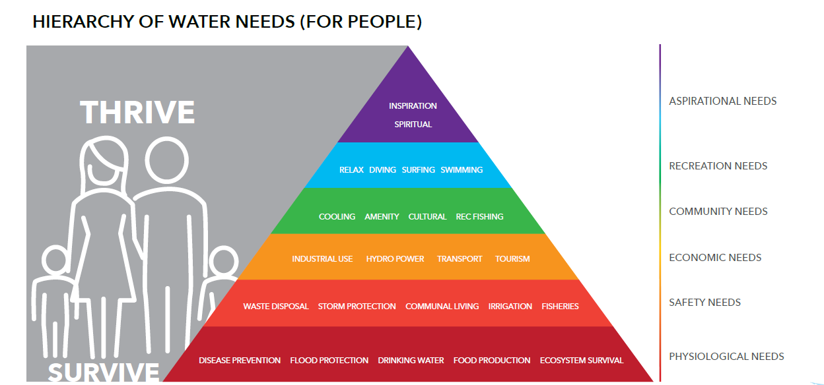
Reason 3: 80/60/45 provides only a fraction of human needs

Slide 9
Complex system
Reason 4: There are many different ways to manage waterway health
Hazards
Values
Notes:
We can use our threat-barrier diagram that we have developed to map out the threats, values and management actions. Now I don’t expect you to read this, it’s just to illustrate the complexity and that it is possible to map it.
CLICK
In Australia, we currently focus on sediment and nutrients for stormwater pollution and we typically only implement 2 types of management actions: biorention basins and gross pollutant traps (GPTs).
We are not fully recognizing the bigger picture.
This threat-barrier diagram can help waterway managers to help see the whole picture and better prioritize projects.

Slide 10
Barrier bypass
Reason 5: Relying solely on 80/60/45 regulations won’t address climate change impacts
Hazards
Values
SEDIMENT
Solution
(e.g. bioretention)
HABITAT
NUTRIENTS
COMMUNITY
DISTURBANCE
COMMERCE
FLOW CHANGE
SALINITY
HEATWAVES
Notes:
Relying solely on 80/60/45 regulations wont address climate change impacts. We can have the best bioretention basin but if sea level rise and heatwaves are prevalent it may degrade waterway values despite our efforts

Slide 11
Hotspots and hot moments
Reason 6: Waterway health can be damaged from acute events, like floods
  90% of pollution can occur from:
  10% of the catchment
  10% of the time
  Michael E. McClain et al, “Biogeochemical Hot Spots and Hot Moments at the Interface of Terrestrial and Aquatic Ecosystems”, Volume 6, Issue 4 – Ecosystems, June 2003

Slide 12
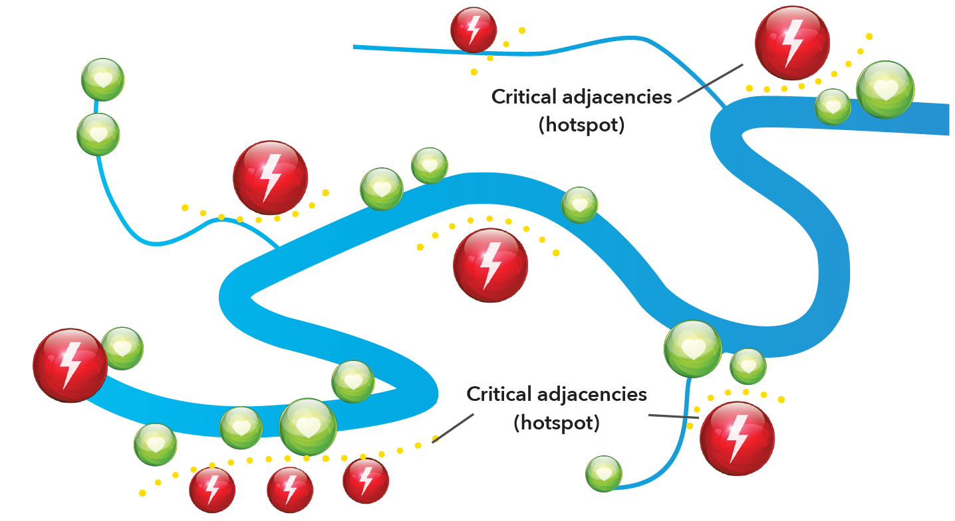
Risk hotspots
Reason 7: Focus efforts on hotspots
Current regulation (e.g. 80/60/45) is one-size-fits-all and does not acknowledge hotspots

Slide 13
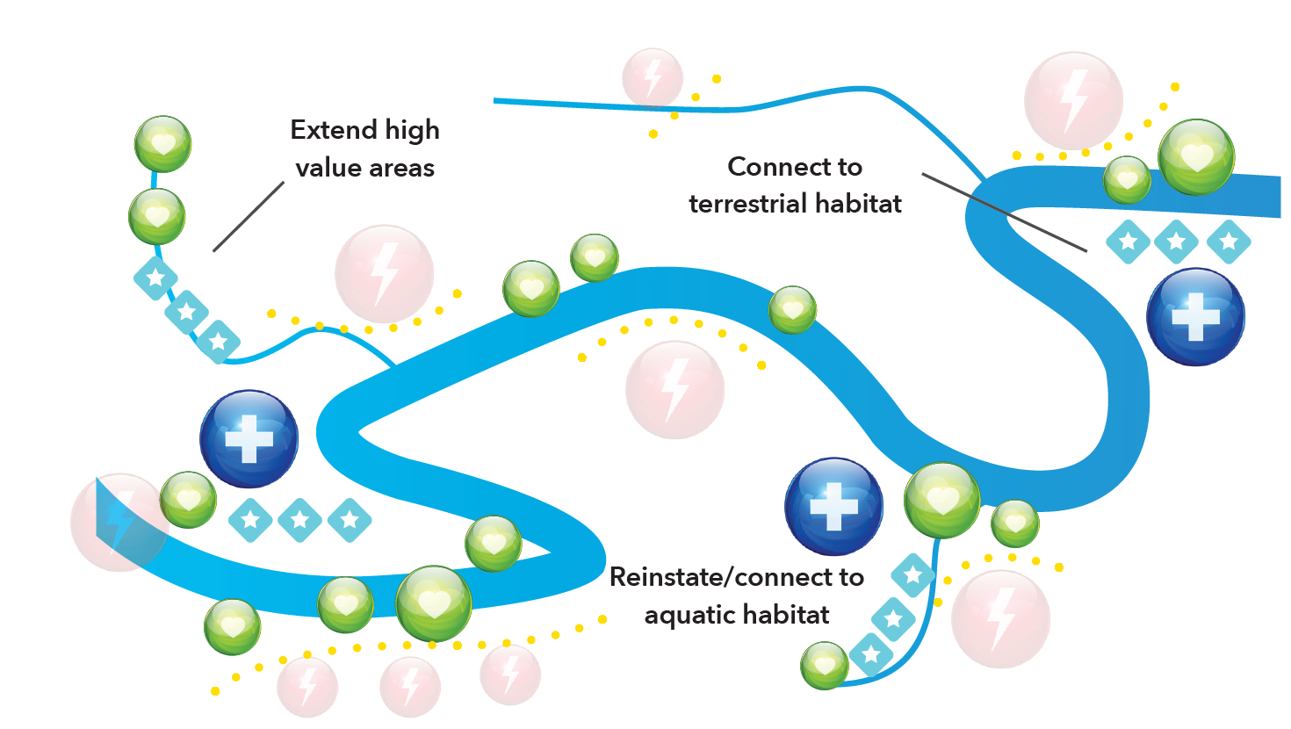
Opportunity hotspots
Reason 8: Look for strategic opportunities to enhance value
Current regulation (e.g. 80/60/45) does not encourage waterway improvement activities

Slide 14
The scale of the issue
Reason 9: Limited time and resources
Last financial year, ~14,000 new lots were given Operational Works Approval (from State records)
The current SPP threshold is lots larger than 2500 m2 in area, and greater than 6 lots – In Brisbane a significant portion of applications fall below this threshold and do not receive treatment (BCC)
In Brisbane, new development applications make up 2 % of the urban footprint (BCC) – At the current rate of renewal it would take `50+ years for the city footprint to be treated via WSUD
Worldwide, 70% of 1st order streams are lost due to urbanisation - Elmore and Kaushal (2008)
The catchment threshold of imperviousness and conventional stormwater drainage associated with poor in-stream ecological condition is just 5–10% - Walsh et al., (2012)

Slide 15

If you have any feedback or questions, please contact Glenn Browning at glenn.b@hlw.org.au
Funded by:

